Slide 1

Linear Model for Body Fat Percentage Estimation
Hao Jiang
Kou Wang
Yicen Liu
10/20/2020
Notes:
In this presentation we will be talking about how we have developed linear models to estimate body fat percentage

Slide 2

Introduction
Body fat percentage is important for health.
Yet, it is hard to measure directly.
Developing a statical model to estimate body fat percentage is more practical.
Notes:
It is important for an individual to learn about his body fat percentage to make diet or exercise plans. Nevertheless, the percentage cannot be easily measured at home. Thus, a method to estimate the percentage with other easily accessible body measures will be more practical.

Slide 3
Motivations
Linear Model
Progressive Model
We have chosen linear models for the following reasons.
Easy to interpret
Physically linear connection between the variables
For users with various level of information, we develop different models
Essential information (Model Level 1)
More detailed information (Model Level 2)
Advanced information (Model Level 3)
Notes:
Linear model
Body fat percentage is derived from density of an individual, which is linearly related to weight and volume. Also, as is shown in the scatter plot of different variables, there exist linear relationship between these variables. Thus, linear models will be sufficient for the problem.
Progressive models
This model will be integrated into an application and intended for users, so to avoid overwhelming number of inputs and for users knowing different levels of information about themselves, different models should be applied.
A precise estimation can be shown with detailed information, while even with little information a simple model can be used for a rough estimation.

Slide 4
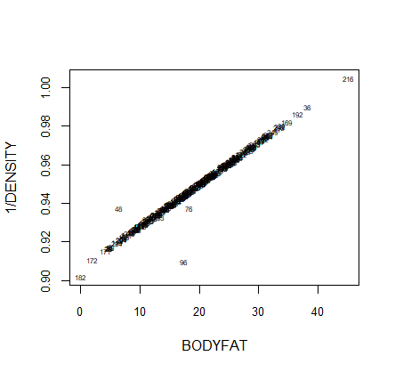
Data Cleaning
Key aspect about the data
Siri’s equation
Influence of the data points
Minimum body fat: 0.00
Minimum density: 0.995
Minimum height 118.5
Bodyfat has a linear relationship with 1/Density
DFFITS
Cook’s distance
Leverage
DFBETAS
Notes:
Hi, I am glad to introduce you how we preprocessed the data and did the data cleaning. What we have mainly done is to find the abnormal data point which are not normal and reasonable. For example people cannot achieve the minimum body fat of 0. Cuz normal human being are not able to have a 0 bodyfat. This is a very extreme example and there exists a few other unreasonable data points or at least we assume they are unreasonable, which probably are the outliers. So I am gonna went through the process of how we find those outliers. In our project, three methods are implemented to find the outliers. First we look into the key aspect about the data, which is the summary and descriptions. There are three points that we assumed abnormal. The minimum bodyfat, minimum density, and minimum height. And then we look into the siri’s equation, which indicates that the inverse of body density has a linear relationship with bodyfat. We checked to see that if every points satisfy such linear relationship and find out those do not. Last, we decide to look at how influential the data points are and find out those points differ significantly from other observations. In this method, four measures are used to find the outliers, which are DFFITS, cook’s distance, leverage and DFBETAs, which measures the difference in each parameter estimate with and without the influential point.

Slide 5
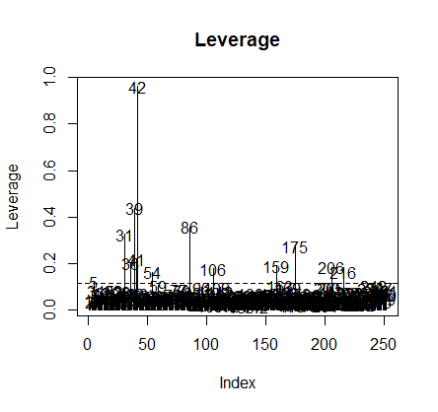
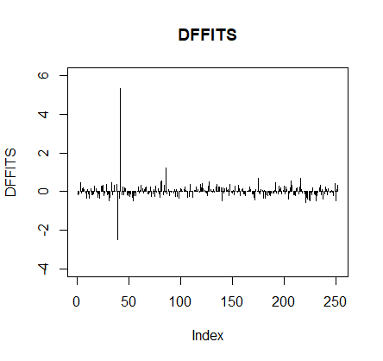
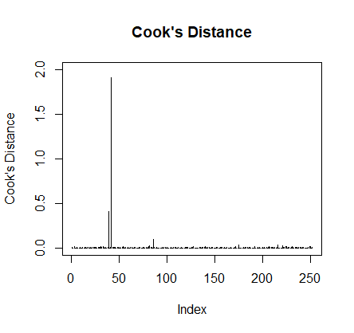
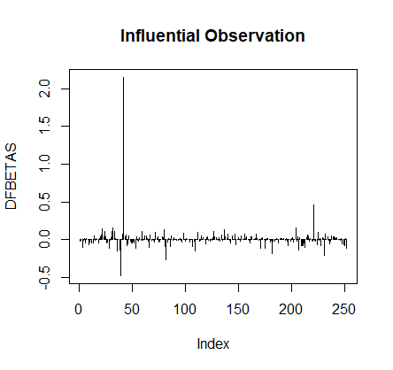
Results
Leverage
DFFITS
Cook’s Distance
DFBETAS
Notes:
Here is a briefly result of our four measures. I’d like to show you how significantly the outliers differ from other observations. After we find out those outliers, we directly dropped those data points.

Slide 6
Final model

Slide 7

Level 1
$$Bodyfat=−26.9576−1.0858×age +2.1092×weight + 0.0068×age ×height − 0.009×weight×height$$
vairable | coefficients
(Intercept) | -26.957559
age | -1.085787
weight | 2.10922586
age:height | 0.00681553
weight:height | -0.0090079

Slide 8
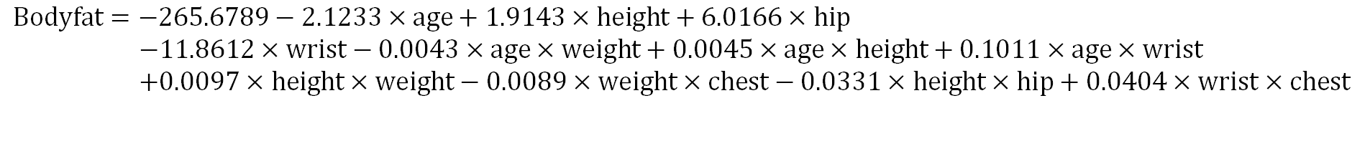
Level 2
$$Bodyfat=−265.6789−2.1233×age+1.9143×height+6.0166×hip$$
$$−11.8612×wrist−0.0043×age×weight+0.0045×age×height+0.1011×age×wrist$$
$$+0.0097×height×weight−0.0089×weight×chest−0.0331×height×hip+0.0404×wrist×chest$$
vairable | (Intercept) | age | height | hip | wrist | age:weight
coefficients | -265.67886 | -2.1233946 | 1.91430515 | 6.01663958 | -11.861231 | -0.0043462
variable | age:height | age:wrist | height:weight | weight:chest | height:hip | wrist:chest
coefficients | 0.00449548 | 0.10111165 | 0.00968907 | -0.0089881 | -0.0330835 | 0.0404527

Slide 9
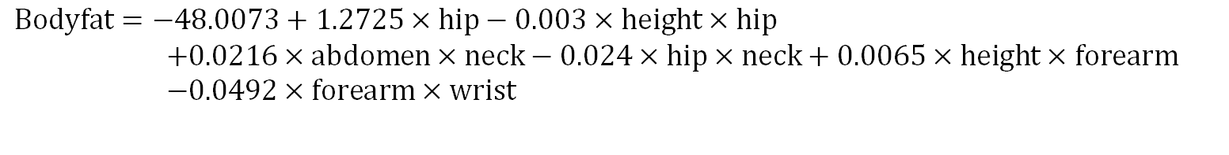
Level 3
$$Bodyfat=−48.0073+1.2725×hip−0.003×height×hip$$
$$+0.0216×abdomen×neck−0.024×hip×neck+0.0065×height×forearm \\ −0.0492×forearm×wrist$$
vairable | (Intercept) | hip | height:hip | abdomen:neck | hip:neck | height:forearm | forearm:wrist
coefficients | -48.00725 | 1.27253573 | -0.0029722 | 0.02162829 | -0.0239823 | 0.00654955 | -0.0491608

Slide 10
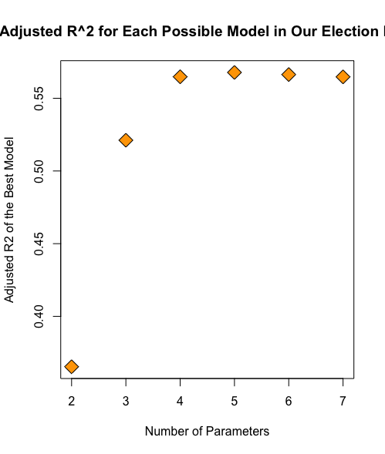
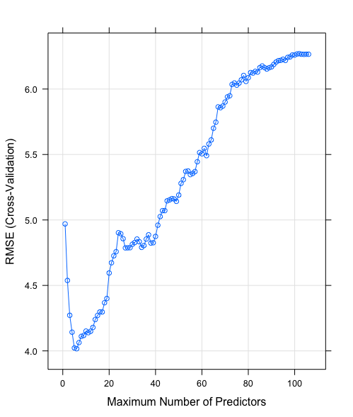
Model selection
Exhaustive search
Backward stepwise regression

Slide 11
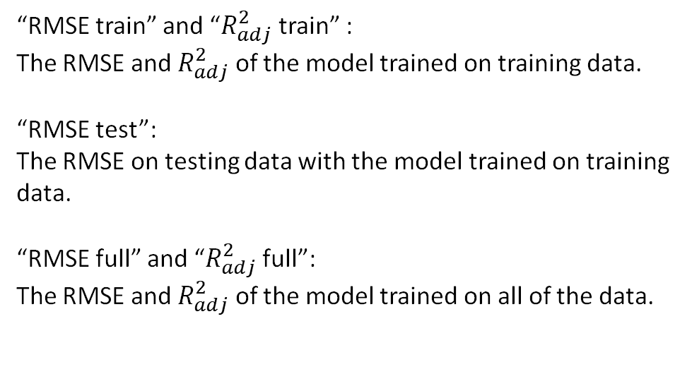
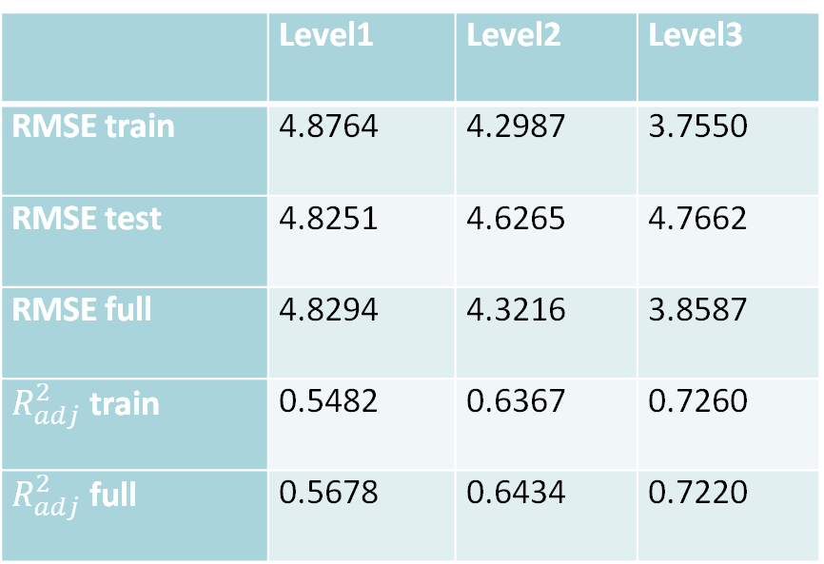
Analysis
Training set 75%
Testing set 25%
 | Level1 | Level2 | Level3
RMSE train | 4.8764 | 4.2987 | 3.7550
RMSE test | 4.8251 | 4.6265 | 4.7662
RMSE full | 4.8294 | 4.3216 | 3.8587
$R_{adj}^{2}$ train | 0.5482 | 0.6367 | 0.7260
$R_{adj}^{2}$ full | 0.5678 | 0.6434 | 0.7220
“RMSE train” and “$R_{adj}^{2}$ train” :
The RMSE and $R_{adj}^{2}$ of the model trained on training data.
“RMSE test”:
The RMSE on testing data with the model trained on training data.
“RMSE full” and “$R_{adj}^{2}$ full”:
The RMSE and $R_{adj}^{2}$ of the model trained on all of the data.

Slide 12
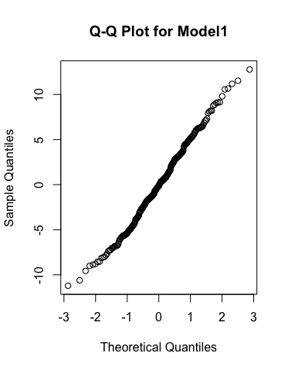
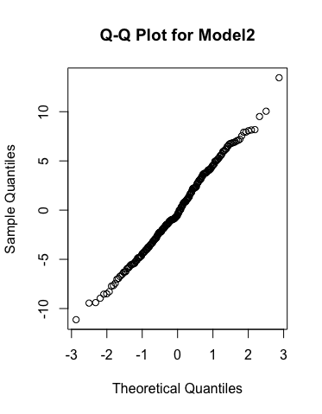
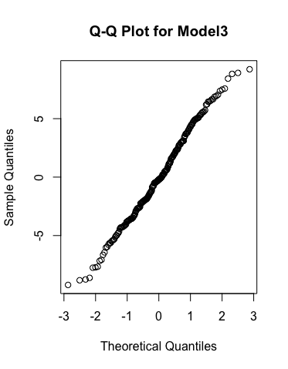
Model diagnostic
Q-Q Plot

Slide 13
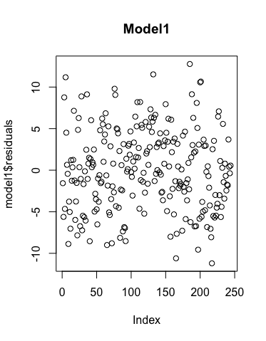
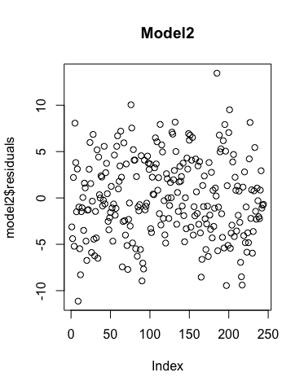
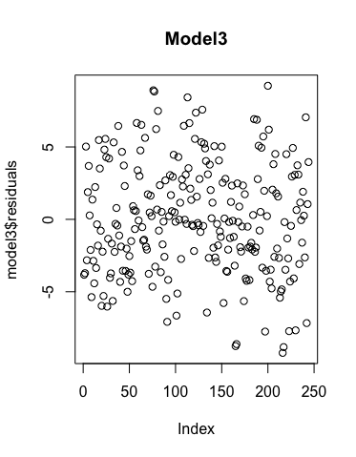
Model diagnostic
Residual Plot

Slide 14
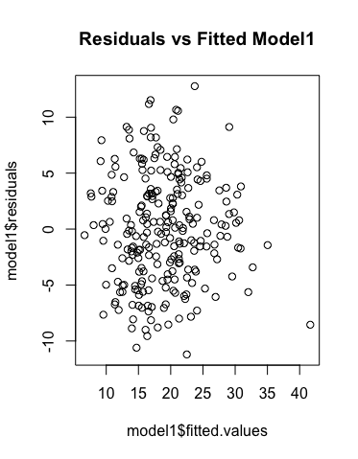
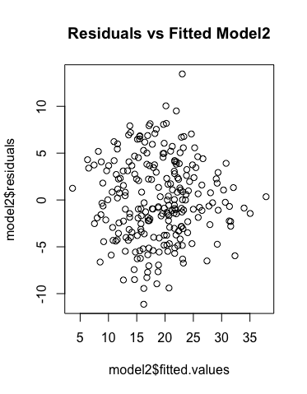
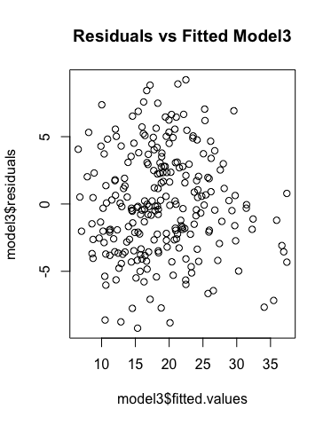
Model diagnostic
Residuals vs Fitted values

Slide 15
Model Strength & Weakness
Exhaustive search
Backward stepwise regression
Advantage
Easy to implement
Always can find the best solution
Disadvantage
Time-consuming
Memory-consuming
Advantage
More efficient than exhaustive search
Ability to manage large amounts of potential predictor variables, fine-tuning the model to choose the best predictor variables from the available options.
Disadvantage
Model may be over-simplifications
It may select several ridiculous explanatory variables.
Notes:
I’d like to compare the two main methods we have used in our models. They are exhaustive search and backward stepwise regression. So for the exhaustive search, it is very easy to implement, and it can always find the best solution. But it also has clear disadvantages. Exhaustive search is extremely time-consuming and memory-consuming. However, our dataset is mall enough so this problem would not be substantial. The second method we have used is backward stepwise regression. It is faster than exhaustive search, and it has ability to manage large amounts of potential predictor variables. But the backward stepwise regression could be over-simplified, which means it may select some unreasonable variable and it is prone to be overfitted.

Slide 16
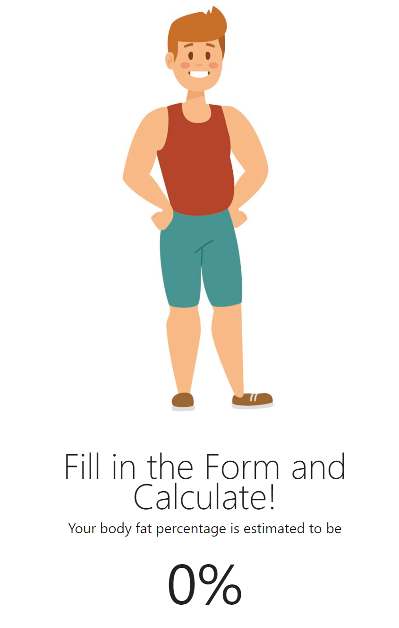
Summary
Data Cleaning
Model Development
Application Development
Notes:
To summarize, in this presentation we have cleaned the data set with various methods. Then we developed three linear models for different users with different levels of precisions. Finally we have developed a web application as a demonstration

Slide 17

Thank you
Contribution:
Hao Jiang: p1-p3, p16-p17
Kou Wang: p4, p5, p15
Yicen Liu: p6-p14

